Slide 1
Servlets
Naveen Kumar K.S
Adith.naveen@gmail.com

Slide 2
CGI (Common Gateway Interface)
Is the very first attempt at providing users with dynamic content
They are written in the native operating system and then stored in a specific directory
Would need to recompile the programs in the new operating system
Running independent programs in CGI, they create their own process
server
client
client
script
script

Slide 3
Servlets
A servlet is an implementation of Java that aims to provide the same service as CGI does
But instead of programs compiled in the native operating system, it compiles into the Java bytecode which is then run in the Java virtual machine
The first advantage of servlets over CGI is in its platform independence
Servlets can run on any operating system just as long as a JVM is installed
Servlets share in the common memory space of the JVM
server
client
client
servlet

Slide 4
Introduction to Servlets
The JavaServerTM product family provides servers that can be configured to run one or more services: bodies of code that implement an application-level protocol, such as FTP, DHCP, or SMTP
Servlets are modules that run inside request/response-oriented services and extend them in some manner

Slide 5
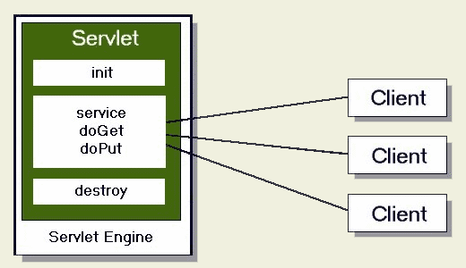
Servlets

Slide 6
Servlets
For example, an HTTP service responds to its clients by delivering the HTML files they request.
A servlet can extend the capabilities of the HTTP service by taking the data that a client entered in an HTML order-entry form and applying the business logic used to update a company's order database.
A servlet can call on other services and servlets to satisfy a request, if appropriate.

Slide 7
Applications of Servlets
Processing data POSTed over HTTPS using an HTML form, including purchase order or credit card data
Allowing collaboration between people
Forwarding requests

Slide 8
Servlet Architecture Overview
The central abstraction in the JSDK is the Servlet interface
All servlets implement this interface, either directly or, more commonly, by extending a class that implements it such as HttpServlet
The Servlet interface provides for methods that manage the servlet and its communications with clients.
Servlet writers provide some or all of these methods when developing a servlet

Slide 9
Servlet Architecture Overview
When a servlet accepts a call from a client it receives two objects: one is a ServletRequest and the other is a ServletResponse
The ServletRequest class encapsulates the communication from the client to the server
The ServletResponse class encapsulates the communication from the servlet back to the client

Slide 10
Servlet Life Cycle
Services load and run servlets
which then accept zero or more requests from clients and return data to them
They can also remove servlets
Important methods
  Init
  Service
  Destroy

Slide 11
Servlet Life Cycle
When a service loads a servlet, it runs the servlet's init method
The service cannot reload a servlet until after it has removed the servlet by calling the destroy method
After the service loads and initializes the servlet, the servlet is able to handle client requests

Slide 12
Servlet Life Cycle
It processes them in its service method
Each client's request has its call to the service method run in its own servlet thread: the method receives the client's request, and sends the client its response
Servlets can run multiple service methods at a time
Servlets run until they are removed from the service

Slide 13
First Servlet
import javax.servlet.*;
import javax.servlet.http.*;
public class Hello extends HttpServlet{
public void doGet(HttpServletRequest req, HttpServletResponse res) throws IOException, ServletException{
// Business Logic
}
}

Slide 14
 | Application Server | Web Server
What is it?: | A server that exposes business logic to client applications through various protocols including HTTP. | A server that handles HTTP protocol.
Functions: | To deliver various applications to another device, it allows everyone in the network to run software off of the same machine. | Keeping HTML, PHP, ASP etc files available for the web browsers to view when a user accesses the site on the web, handles HTTP requests from clients.
Clients can include-: | GUI’s, Web Servers | HTTP, HTML
Functionality: | Adds functionality | Does not add any
Examples of popular server products: | Sun Java Application server, weblogic server, Apache Geronimo | Apache, Microsoft IIS

